Slide 1
MATH-352 Numerical Methods
Atifa Kanwal
atifa.kanwal@seecs.edu.pk
Office # 303, Faculty Block, SEECS, NUST

Slide 2
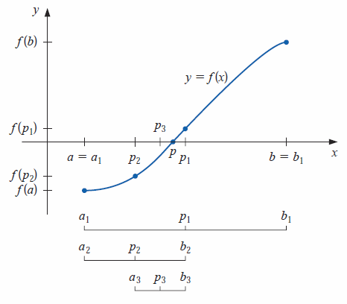
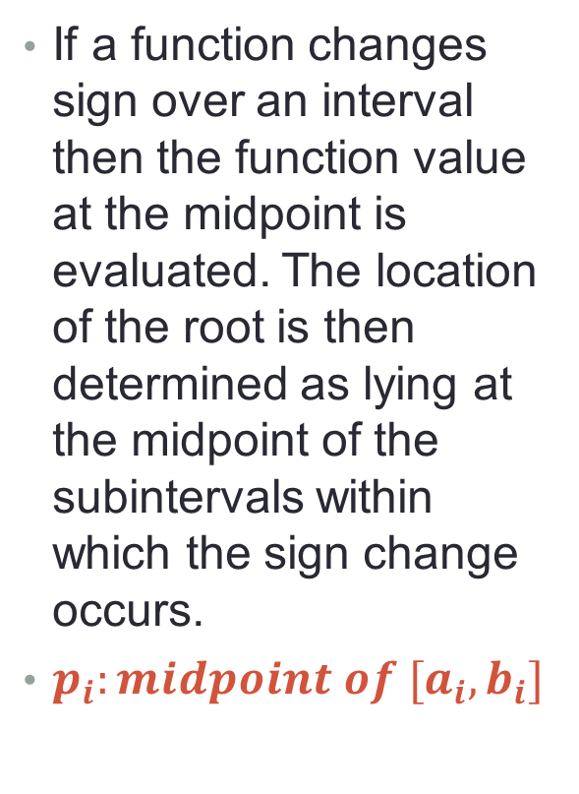
1. Bisection Method
If a function changes sign over an interval then the function value at the midpoint is evaluated. The location of the root is then determined as lying at the midpoint of the subintervals within which the sign change occurs.
$p_{i}:midpoint of [a_{i},b_{i}]$

Slide 3
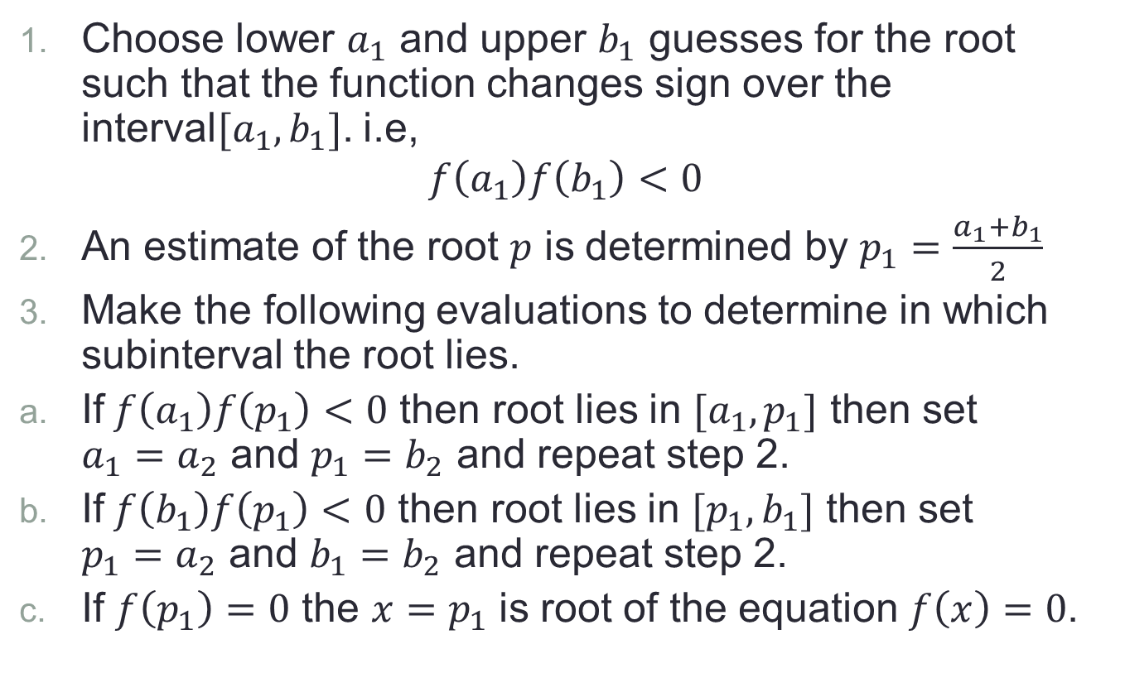
Algorithm
Choose lower $a_{1}$ and upper $b_{1}$ guesses for the root such that the function changes sign over the interval$[a_{1},b_{1}]$. i.e,
$$f\left(a_{1}\right)f\left(b_{1}\right)<0$$
An estimate of the root $p$ is determined by $p_{1}=\frac{a_{1}+b_{1}}{2}$
Make the following evaluations to determine in which subinterval the root lies.
If$f\left(a_{1}\right)f\left(p_{1}\right)<0$ then root lies in $[a_{1},p_{1}]$ then set $a_{1}=a_{2}$ and $p_{1}=b_{2}$ and repeat step 2.
If$f\left(b_{1}\right)f\left(p_{1}\right)<0$ then root lies in $[p_{1},b_{1}]$ then set $p_{1}=a_{2}$ and $b_{1}=b_{2}$ and repeat step 2.
If $f\left(p_{1}\right)=0$ the $x=p_{1}$ is root of the equation $f\left(x\right)=0$.

Slide 4
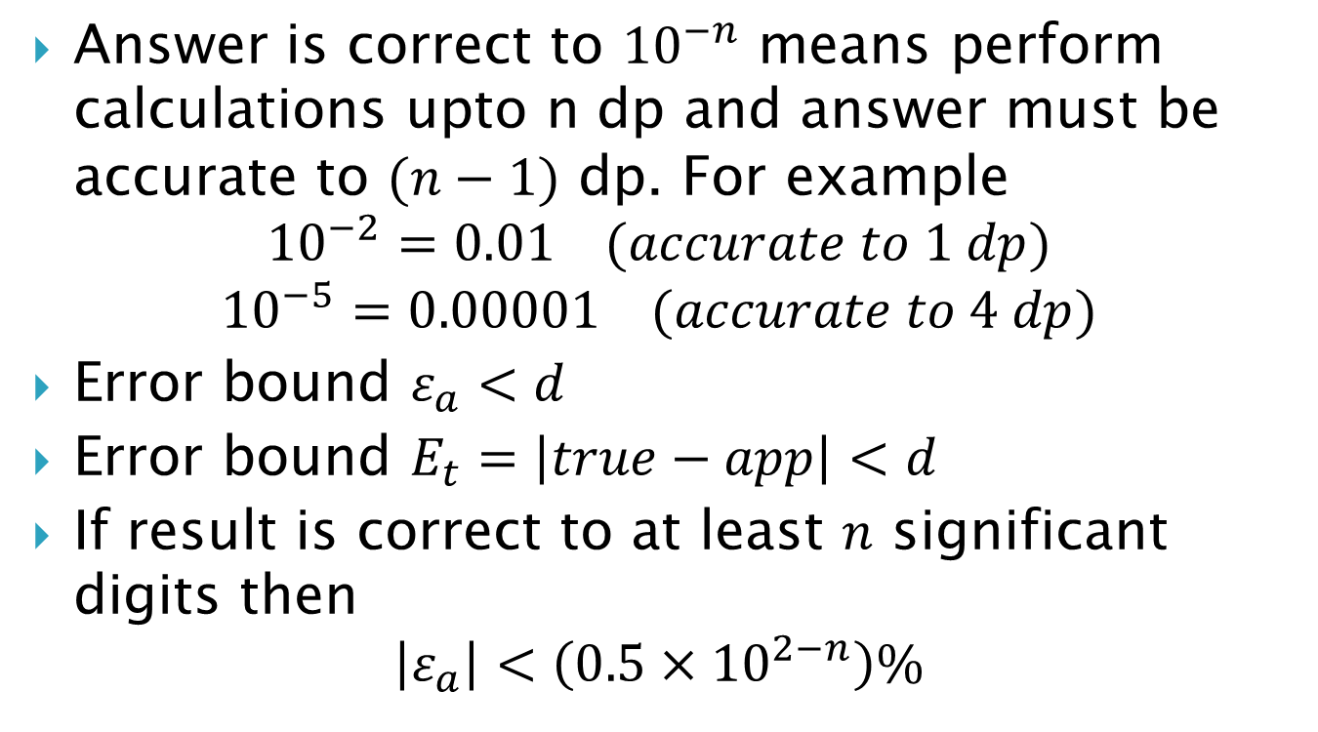
Stopping/Termination Criterion
Answer is correct to ${10}^{−n}$ means perform calculations upto n dp and answer must be accurate to $(n−1)$ dp. For example
$${10}^{−2}=0.01 (accurate to 1 dp)$$
$${10}^{−5}=0.00001 (accurate to 4 dp)$$
Error bound $ε_{a}<d$
Error bound $E_{t}=\left|true−app\right|<d$
If result is correct to at least $n$ significant digits then
$$\left|ε_{a}\right|<\left(0.5×{10}^{2−n}\right)\%$$

Slide 5
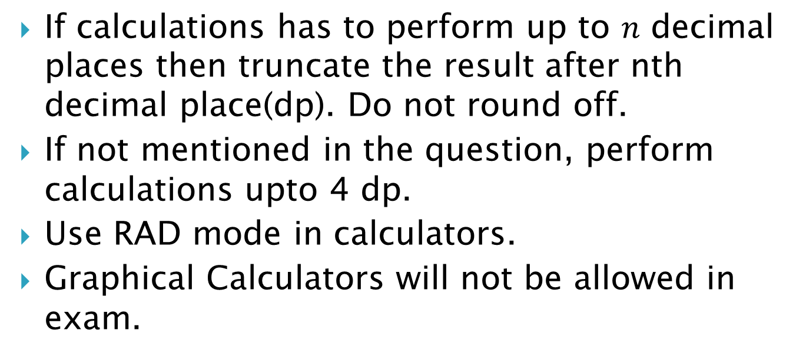
Instructions about Calculations in this course
If calculations has to perform up to $n$ decimal places then truncate the result after nth decimal place(dp). Do not round off.
If not mentioned in the question, perform calculations upto 4 dp.
Use RAD mode in calculators.
Graphical Calculators will not be allowed in exam.

Slide 6
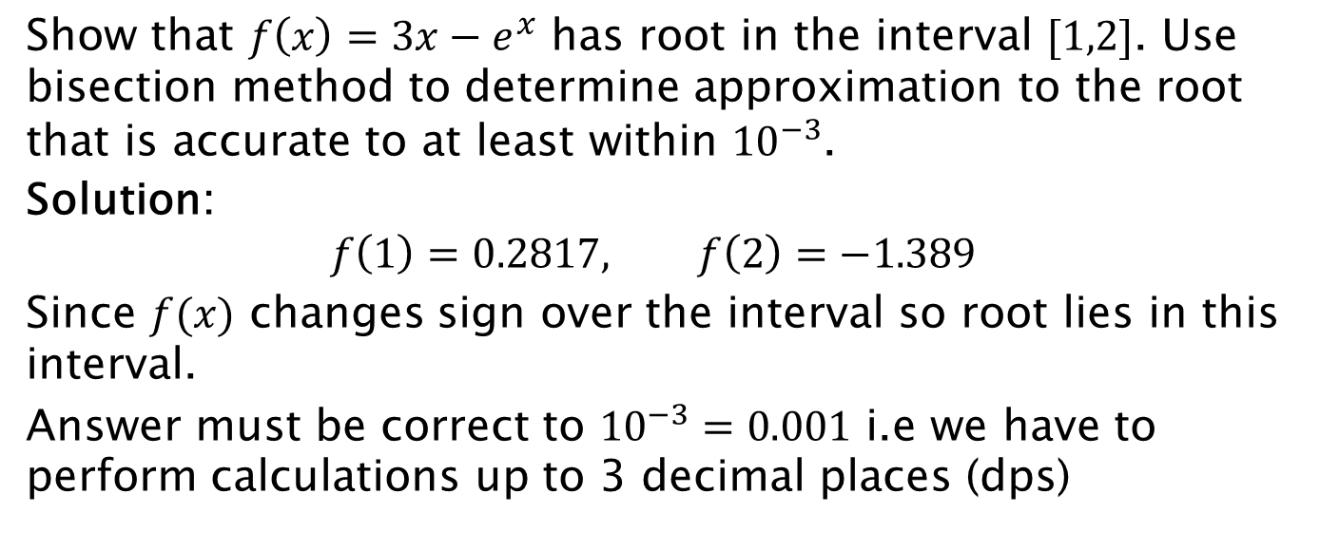
Example 1:
Show that $f\left(x\right)=3x−e^{x}$ has root in the interval $[1,2]$. Use bisection method to determine approximation to the root that is accurate to at least within ${10}^{−3}$.
Solution:
$$f\left(1\right)=0.2817, f\left(2\right)=−1.389$$
Since $f(x)$ changes sign over the interval so root lies in this interval.
Answer must be correct to ${10}^{−3}=0.001$ i.e we have to perform calculations up to 3 decimal places (dps)

Slide 7
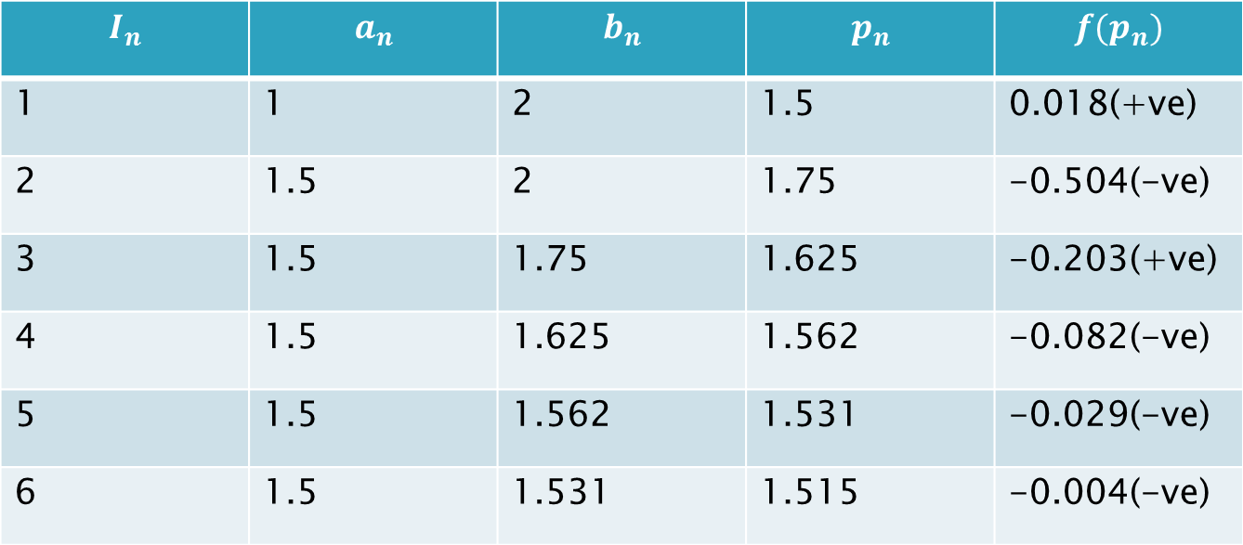

Example 1: Solution $f\left(x\right)=3x−e^{x}$
$$I_{n}$$ | $$a_{n}$$ | $$b_{n}$$ | $$p_{n}$$ | $$f(p_{n})$$
1 | 1 | 2 | 1.5 | 0.018(+ve)
2 | 1.5 | 2 | 1.75 | -0.504(-ve)
3 | 1.5 | 1.75 | 1.625 | -0.203(+ve)
4 | 1.5 | 1.625 | 1.562 | -0.082(-ve)
5 | 1.5 | 1.562 | 1.531 | -0.029(-ve)
6 | 1.5 | 1.531 | 1.515 | -0.004(-ve)
The root of the equation is $x=1.515$.

Slide 8
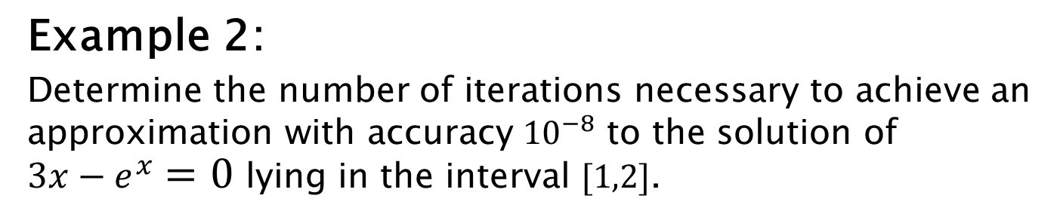
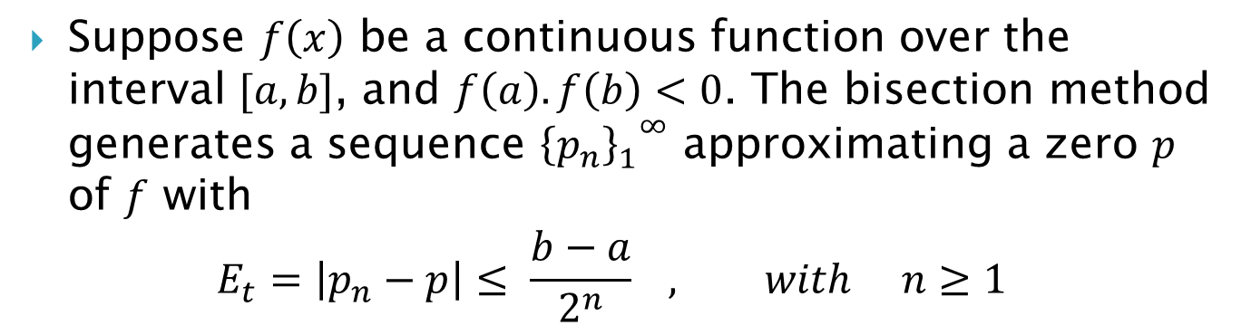
Theorem: Error Bound for Bisection Method
Suppose $f\left(x\right)$ be a continuous function over the interval $[a,b]$, and $f\left(a\right).f\left(b\right)<0$. The bisection method generates a sequence ${{\left\{p_{n}\right\}}_{1}^{}}^{∞}$ approximating a zero $p$ of $f$ with
$$E_{t}=\left|p_{n}−p\right|≤ \frac{b−a}{2^{n}} , with n≥1$$
Example 2:
Determine the number of iterations necessary to achieve an approximation with accuracy ${10}^{−8}$ to the solution of $3x−e^{x}=0$ lying in the interval $[1,2]$.

Slide 9
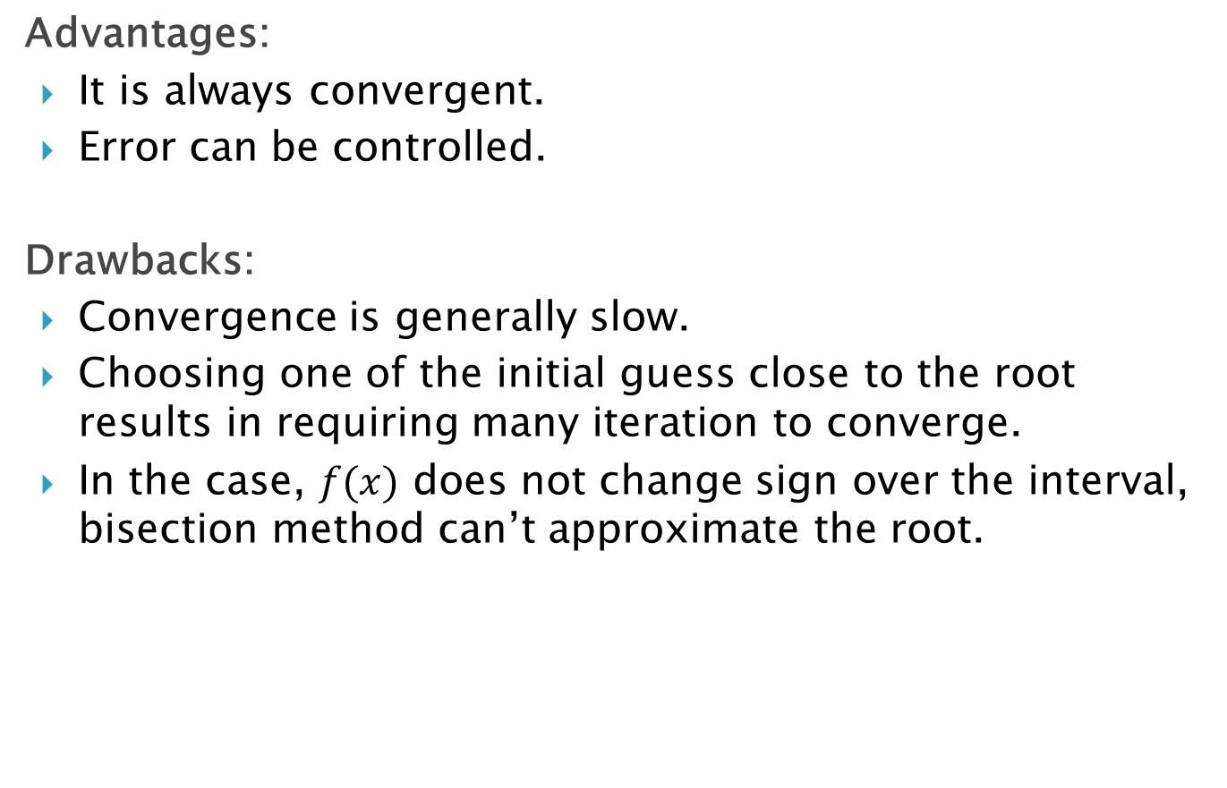
Advantages of Bisection Method
Advantages:
It is always convergent.
Error can be controlled.
Drawbacks:
Convergence is generally slow.
Choosing one of the initial guess close to the root results in requiring many iteration to converge.
In the case, $f(x)$ does not change sign over the interval, bisection method can’t approximate the root.

Slide 10
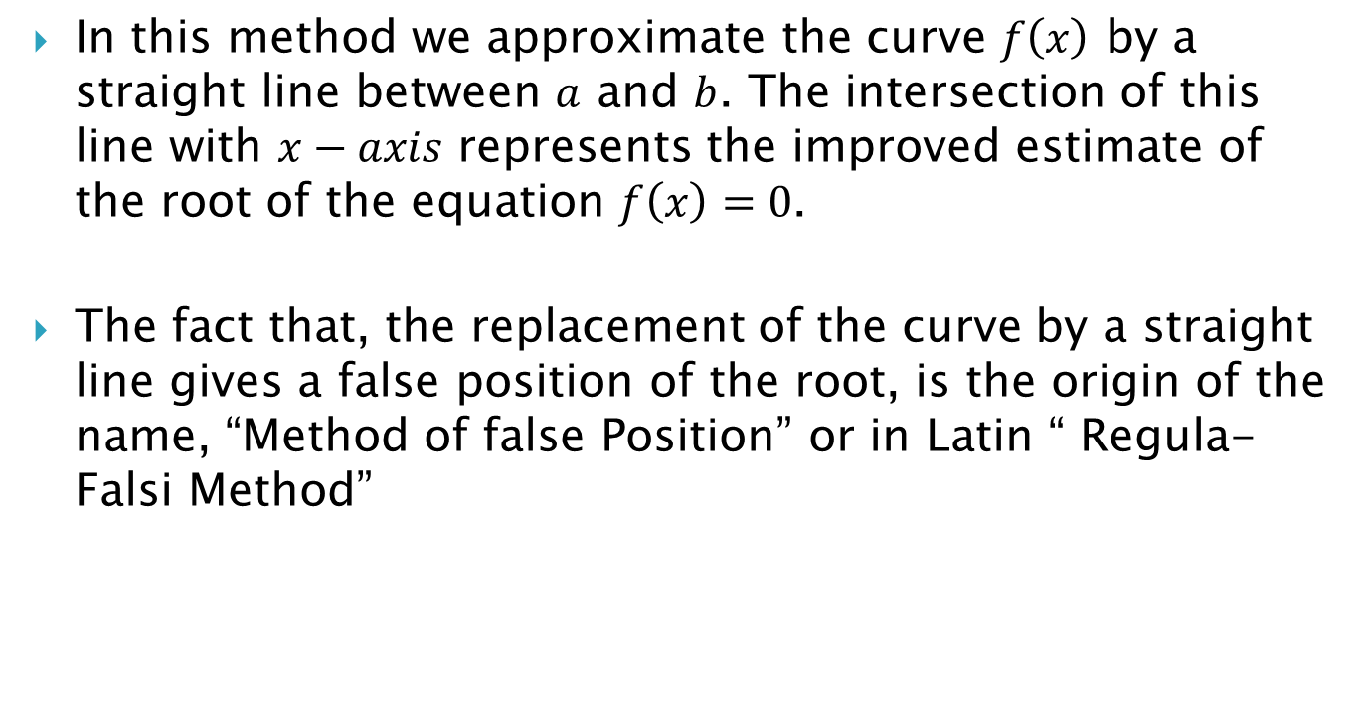
The False Position Method
In this method we approximate the curve $f\left(x\right)$ by a straight line between $a$ and $b$. The intersection of this line with $x−axis$ represents the improved estimate of the root of the equation $f\left(x\right)=0$.
The fact that, the replacement of the curve by a straight line gives a false position of the root, is the origin of the name, “Method of false Position” or in Latin “ Regula-Falsi Method”

Slide 11

False Position Method Graphically
$$f\left(b_{1}\right)$$
$$p_{1}$$
$$a_{1}$$
$$b_{1}$$
$$f\left(p_{1}\right)$$
$$f\left(a_{1}\right)$$

Slide 12
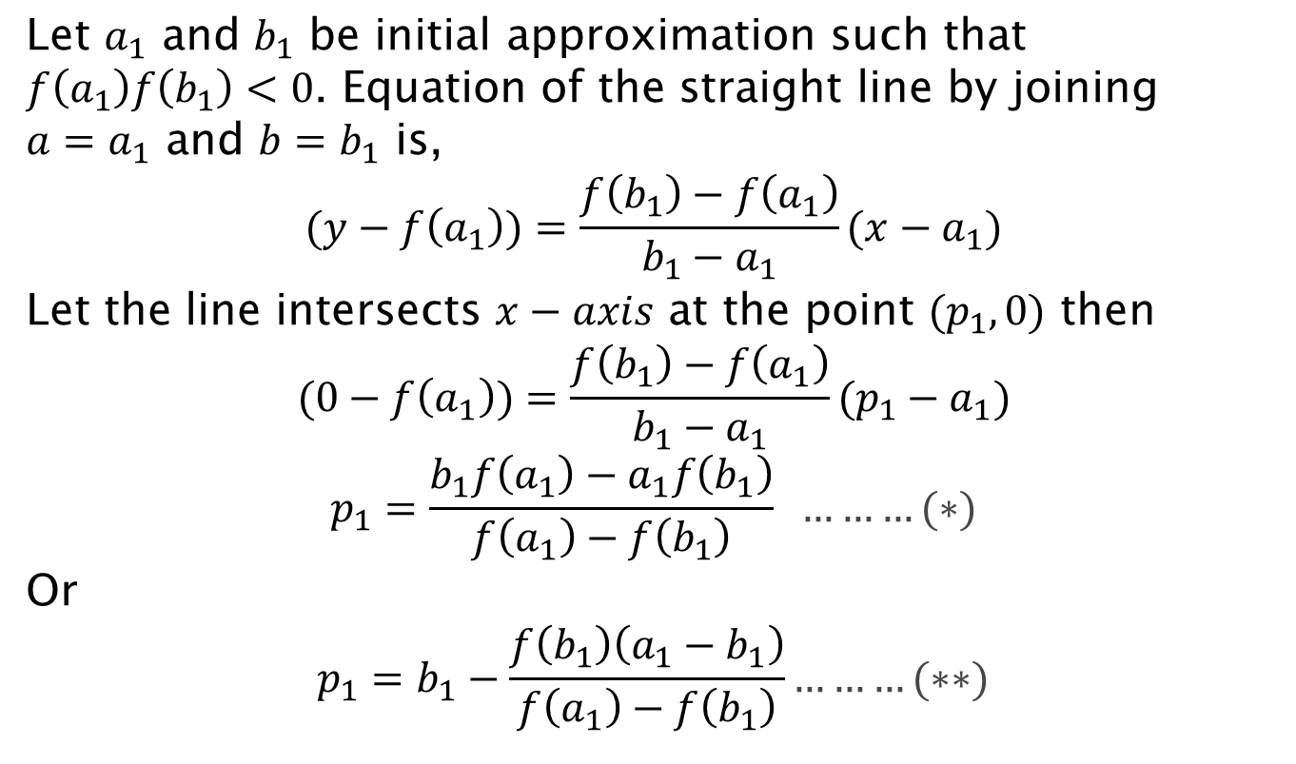
Derivation of Formula
Let $a_{1}$ and $b_{1}$ be initial approximation such that $f\left(a_{1}\right)f\left(b_{1}\right)<0$. Equation of the straight line by joining $a=a_{1}$ and $b=b_{1}$ is,
$$(y−f\left(a_{1}\right))=\frac{f\left(b_{1}\right)−f\left(a_{1}\right)}{b_{1}−a_{1}}(x−a_{1})$$
Let the line intersects $x−axis$ at the point $(p_{1},0)$ then
$$(0−f\left(a_{1}\right))=\frac{f\left(b_{1}\right)−f\left(a_{1}\right)}{b_{1}−a_{1}}(p_{1}−a_{1})$$
$$p_{1}=\frac{b_{1}f\left(a_{1}\right)−a_{1}f\left(b_{1}\right)}{f\left(a_{1}\right)−f\left(b_{1}\right)} ………(∗)$$
Or
$$p_{1}=b_{1}−\frac{f\left(b_{1}\right)\left(a_{1}−b_{1}\right)}{f\left(a_{1}\right)−f\left(b_{1}\right)}………(∗∗)$$

Slide 13
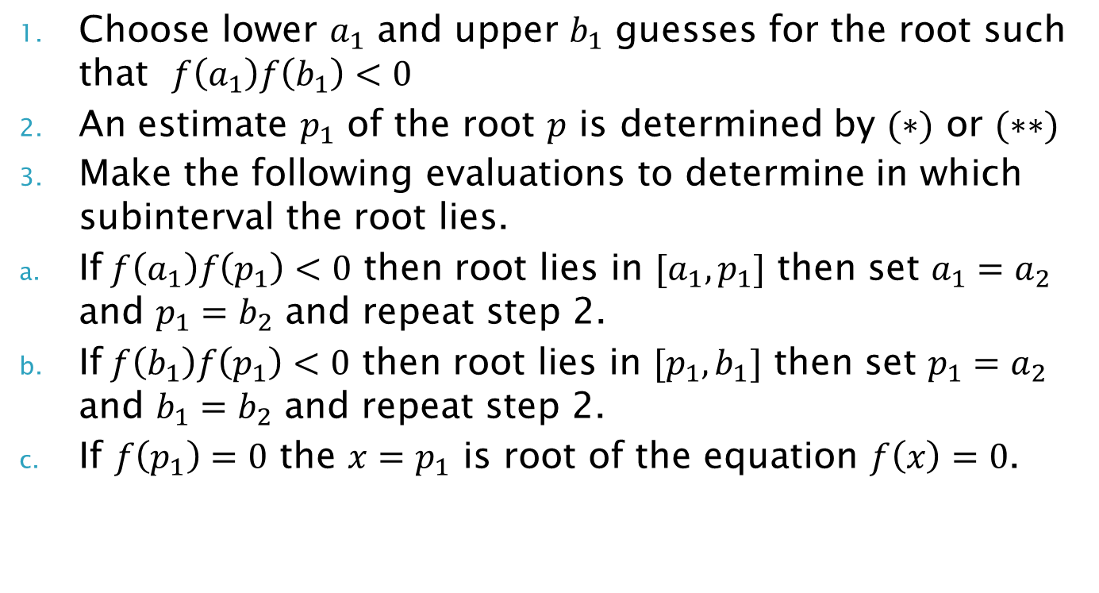
Algorithm
Choose lower $a_{1}$ and upper $b_{1}$ guesses for the root such that $f\left(a_{1}\right)f\left(b_{1}\right)<0$
An estimate $p_{1}$ of the root $p$ is determined by $(∗)$ or $(∗∗)$
Make the following evaluations to determine in which subinterval the root lies.
If$f\left(a_{1}\right)f\left(p_{1}\right)<0$ then root lies in $[a_{1},p_{1}]$ then set $a_{1}=a_{2}$ and $p_{1}=b_{2}$ and repeat step 2.
If$f\left(b_{1}\right)f\left(p_{1}\right)<0$ then root lies in $[p_{1},b_{1}]$ then set $p_{1}=a_{2}$ and $b_{1}=b_{2}$ and repeat step 2.
If $f\left(p_{1}\right)=0$ the $x=p_{1}$ is root of the equation $f\left(x\right)=0$.

Slide 14
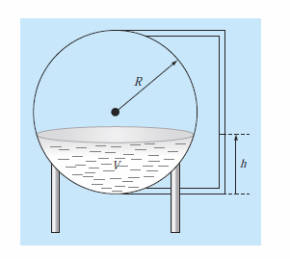
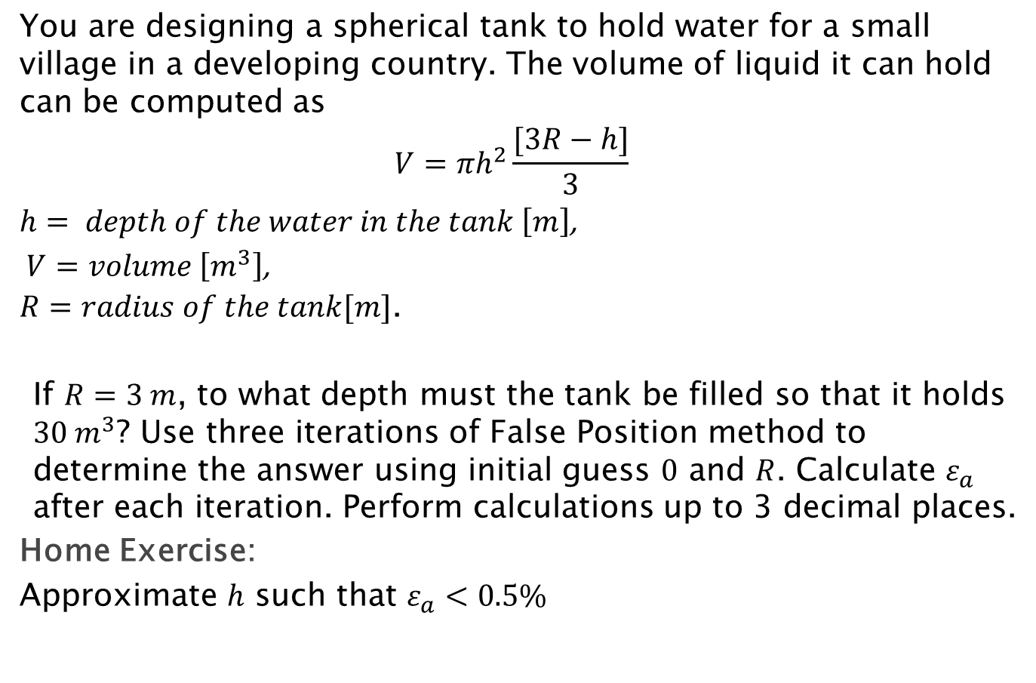
Example 3
You are designing a spherical tank to hold water for a small village in a developing country. The volume of liquid it can hold can be computed as
$$V=πh^{2}\frac{[3R−h]}{3}$$
$h= depth of the water in the tank \left[m\right]$,
$V=volume \left[m^{3}\right]$,
$R=radius of the tank[m]$.
If $R=3 m$, to what depth must the tank be filled so that it holds $30 m^{3}$? Use three iterations of False Position method to determine the answer using initial guess $0$ and $R$. Calculate $ε_{a}$ after each iteration. Perform calculations up to 3 decimal places.
Home Exercise:
Approximate $h$ such that $ε_{a}<0.5\%$

Slide 15
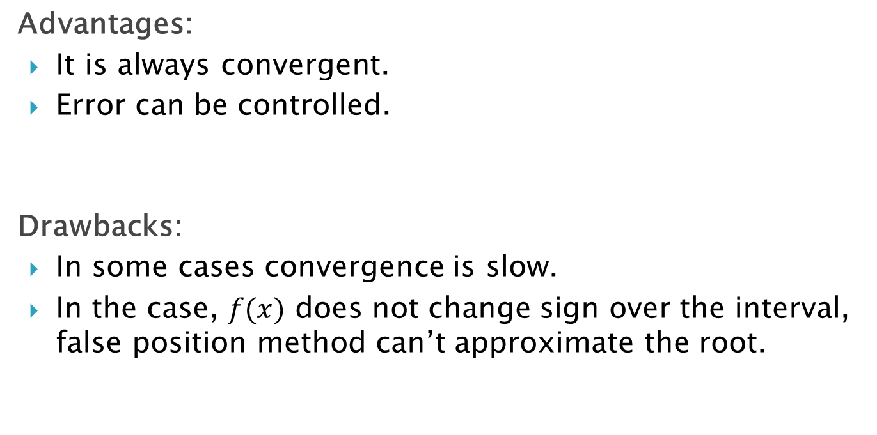
Advantages:
It is always convergent.
Error can be controlled.
Drawbacks:
In some cases convergence is slow.
In the case, $f(x)$ does not change sign over the interval, false position method can’t approximate the root.

